Slide 1

Her AI
AI4Good Lab
Summer 2020
Notes:
Before we start the pitch, we would like to have a disclaimer as the pictures in this presentation are graphic.
Hello, We are HerAI and we provide personalized health care for women.

Slide 2

Motivation
Notes:
This is Lily. she is a 27-year old woman who was diagnosed with CC after suffering from horrible pain for almost a year. After few weeks of treatment, she wasn’t getting better. Her doctor discovered that she was on a wrong treatment plan because the position of her cervix had been misclassified.
Thankfully, the doctors were able to change her treatment on time and she is now a cancer survivor.
But like Lily, there are thousands of women whose mistreatment goes undiscovered.
Let’s think how lily’s life would have been different if she was able to know that she was high risk and how it would have been different if there was a tool to better assess the position of her cervix.
(but dont get the chance of getting diagnosed at the right time with the right treatment)

Slide 3
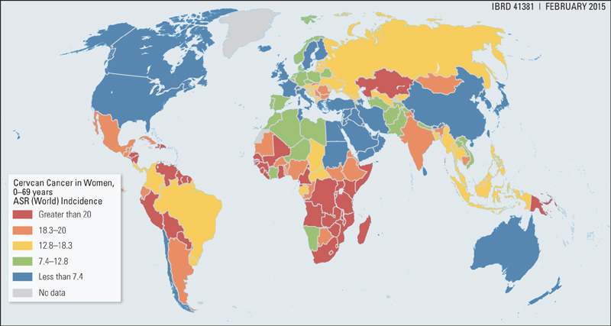
4th most common cancer
90% preventable
311 000
deaths in 2018
Notes:
And yet in 2018, 311 000 women died from this disease.
This is due to three main reasons:

Slide 4
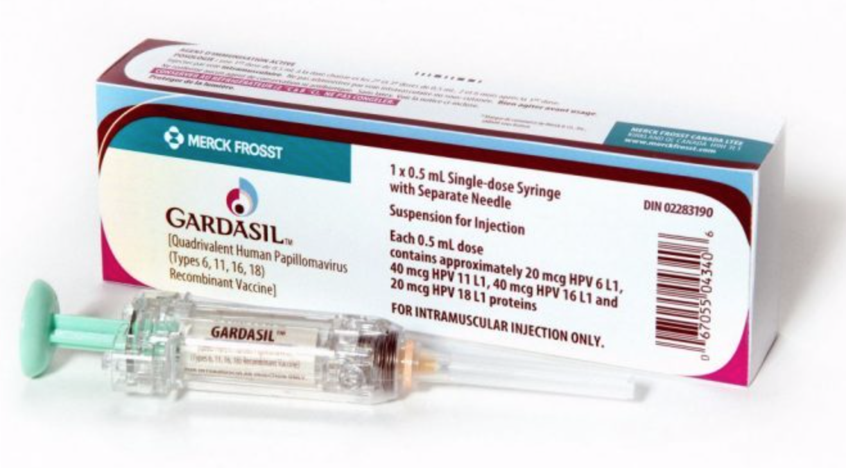
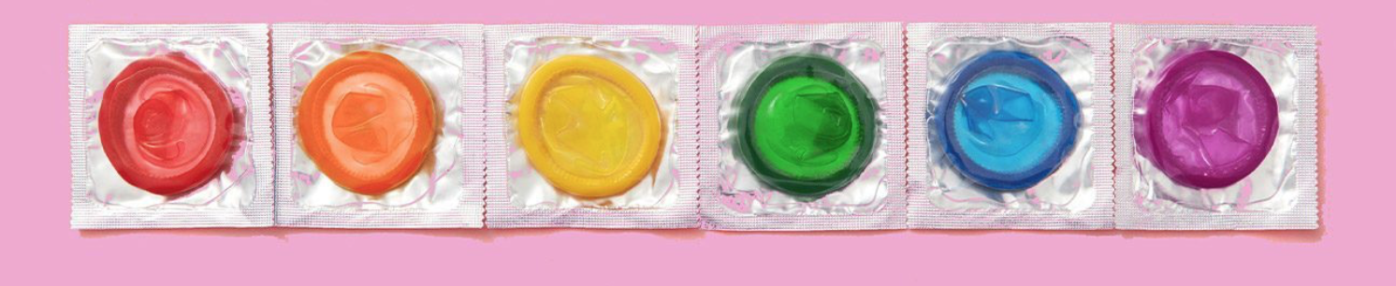
Lack of sexual health education
Notes:
Lack of sexual health education
In many societies around the world, it is still a taboo to talk about Sexually Transmitted Infections which are the major cause of cervical cancer.
As a result, women are often not aware of protection methods or of the risk of developing cancer.

Slide 5
Lack of sexual health education
No access to screening
Notes:
2. No access to screening
Many women do not have access to screening centres and even when they do, Doctors are not always able to accurately diagnose precancerous cells in the cervix.

Slide 6
Lack of sexual health education
No access to screening
Poorly customized treatment
Notes:
3. Poorly customized treatment
Even when the precancerous cells are screened accurately, treatments are seldom properly adapted to the individual patient’s cervix position. This can be extremely dangerous because “A treatment which works effectively for one woman may obscure future cancerous growth in another woman.”

Slide 7
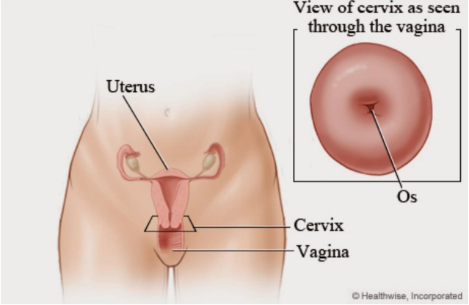
Notes:
But What do we mean by the position of the cervix? What is the cervix anyway?
The cervix is located at the entrance of the uterus.

Slide 8
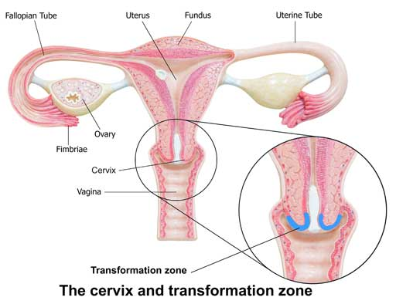
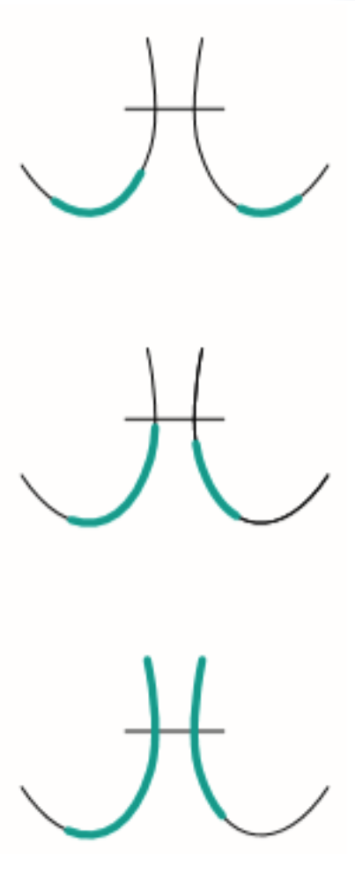
Notes:
It has a part called transformation zone, which is, the most common place for abnormal cells to develop.
Based on the visibility of this transformation zone in each patient,
Disclaimer: the pictures in the following slide contains blood,

Slide 9
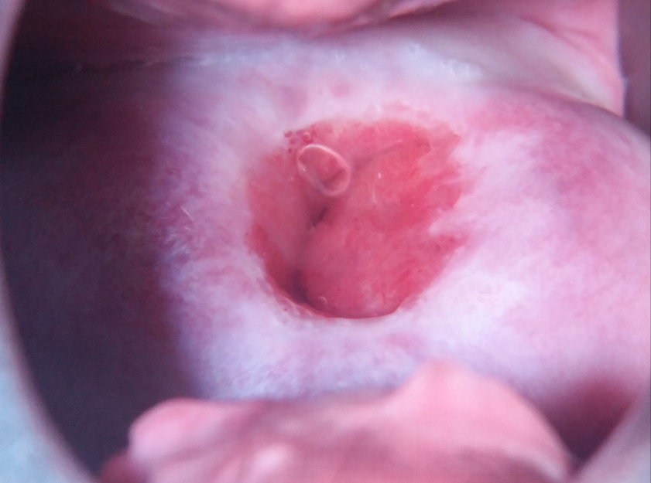
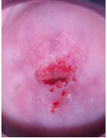
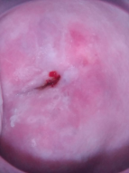
Cervix Types
Type 1
Type 2
Type 3
Notes:
The position of the cervix is classified into three different types
In type 1, the transformation zone is fully visible. With type 2, it is semi visible and with type 3, it is not visible at all.
It is very difficult for doctors as well, to distinguish between the types as the position is not always this clear.

Slide 10
Solution: HerAI
1. Cervical cancer risk prediction (linear SVC) 2. Cervix position classification (CNN)

Slide 11
MODEL 1: Cervix type classification
INPUT
8000 .jpg images
OUTPUT
Type 1, type 2 or type 3
CNN
Notes:
We built CNN model where the input is images divided into train, test & validation. Preprocessing : We normalized the pixel values of each image by channel before resizing and horizontally flipping the images. So We first created our own model and we obtained 51% accuracy. Then we used denset121 to capture more features and obtained an accuracy of 66%.
Then the best model so far was resnet18 with additional preprocessing functions with accuracy of 70 % which is fairly comparable to the benchmark of kaggle.

Slide 12
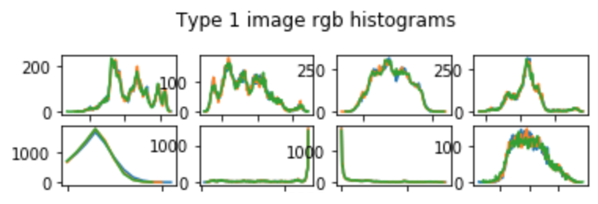
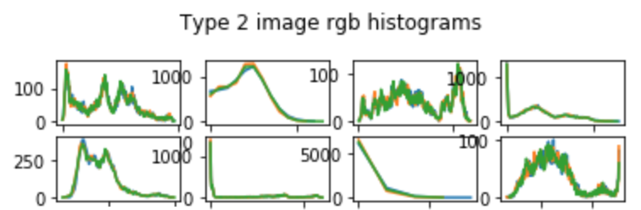
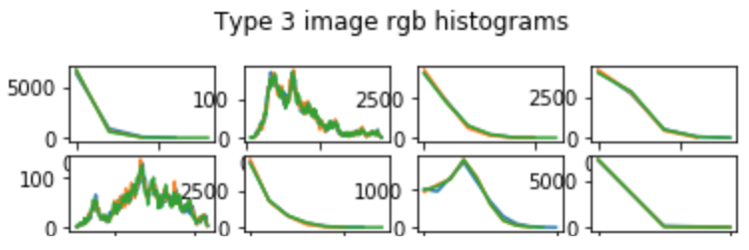
MODEL 1: Cervix type classification
Notes:
Then we wanted to make more accurate so we used color as an identifier for image segmentation. Here we plotted histogram you can see here the histogram of 8 images of each type. There was not standard trend in however there was some areas where it is greater than the other so we used contrast split segmentation mask where we binarizing the intensity based on threshold to distinguish between bright and dark components of the image

Slide 13
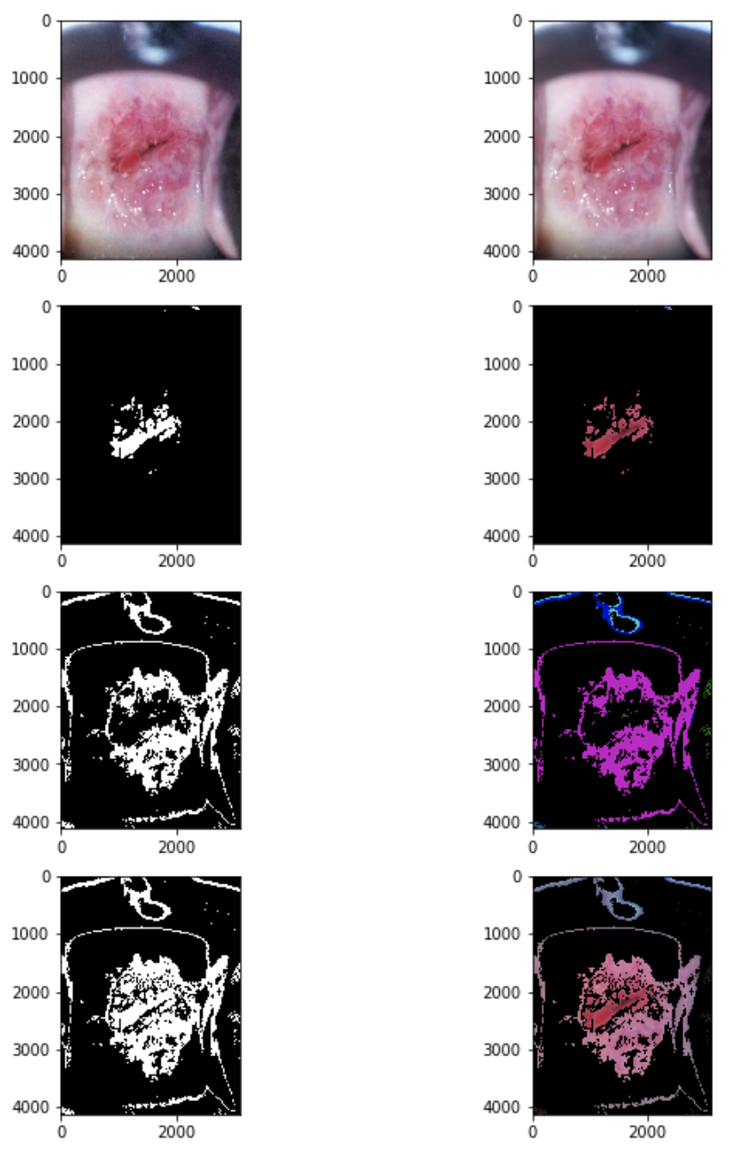
Segmentation
Notes:
Then when we combined those too mask together . The result is a fairly good representation of the cervix which can be fed to the model to potentially yield better accuracy. To the best of our knowledge, no one on kaggle has used this approach for segmentation. So we are excited to apply it on the whole dataset and study the difference

Slide 14
Segmentation
Notes:
Then when we combined those too mask together . The result is a fairly good representation of the cervix which can be fed to the model to potentially yield better accuracy. To the best of our knowledge, no one on kaggle has used this approach for segmentation. So we are excited to apply it on the whole dataset and study the difference

Slide 15
Segmentation
Notes:
Then when we combined those too mask together . The result is a fairly good representation of the cervix which can be fed to the model to potentially yield better accuracy. To the best of our knowledge, no one on kaggle has used this approach for segmentation. So we are excited to apply it on the whole dataset and study the difference

Slide 16
Segmentation
Notes:
Then when we combined those too mask together . The result is a fairly good representation of the cervix which can be fed to the model to potentially yield better accuracy. To the best of our knowledge, no one on kaggle has used this approach for segmentation. So we are excited to apply it on the whole dataset and study the difference

Slide 17
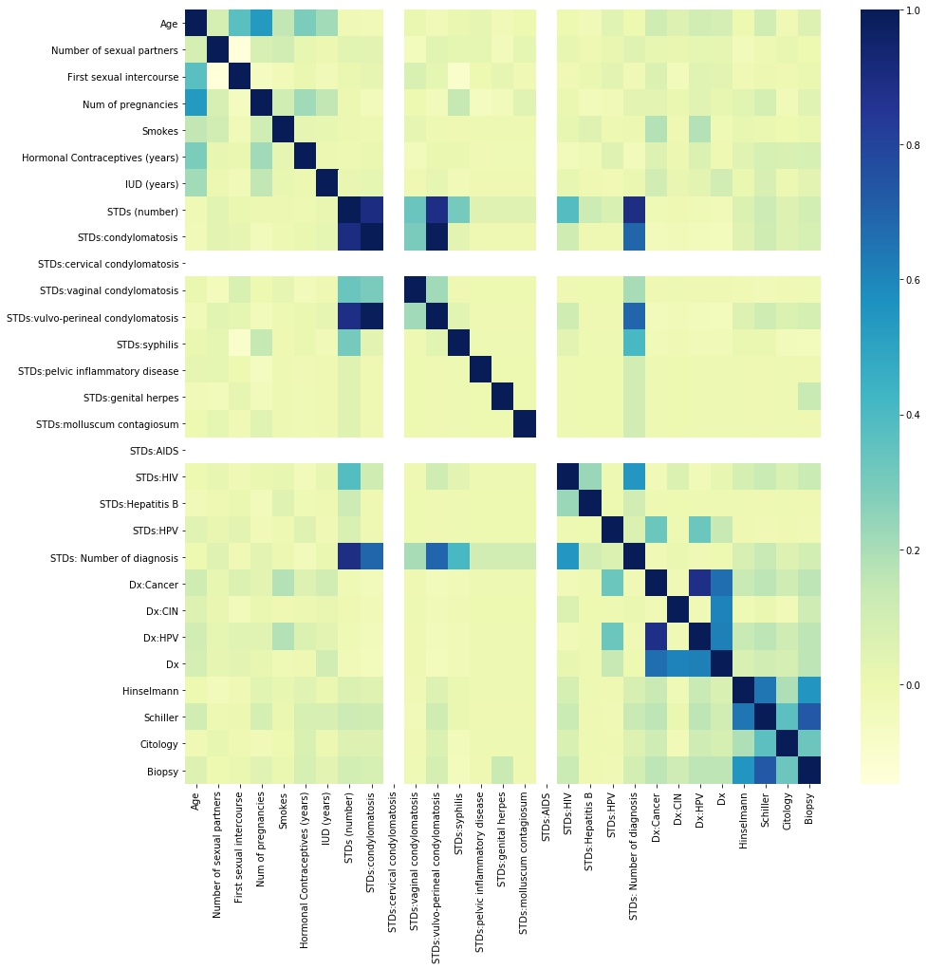
MODEL 2: Cervical Cancer Risk Prediction Score
INPUT
N = 858 (55 with cervical cancer)

Slide 18
MODEL 2: Cervical Cancer Risk Prediction Score
INPUT
N = 858 (55 with cervical cancer)
Sexual history

Slide 19
MODEL 2: Cervical Cancer Risk Prediction Score
INPUT
N = 858 (55 with cervical cancer)
Sexual history
Contraceptive history

Slide 20
MODEL 2: Cervical Cancer Risk Prediction Score
INPUT
N = 858 (55 with cervical cancer)
Sexual history
Contraceptive history
STD medical history

Slide 21
MODEL 2: Cervical Cancer Risk Prediction Score
INPUT
N = 858 (55 with cervical cancer)

Slide 22
MODEL 2: Cervical Cancer Risk Prediction Score
INPUT
N = 858 (55 with cervical cancer)
Linear SVC
→ C = 0.5
→ squared hinge loss
→ L2 penalty

Slide 23
MODEL 2: Cervical Cancer Risk Prediction Score
INPUT
N = 858 (55 with cervical cancer)
Linear SVC
→ C = 0.5
→ squared hinge loss
→ L2 penalty

Slide 24
MODEL 2: Cervical Cancer Risk Prediction Score
INPUT
N = 858 (55 with cervical cancer)
OUTPUT
Cervical Cancer Risk Prediction Score: 0 (no risk) to 4 (high risk)
Linear SVC
→ C = 0.5
→ squared hinge loss
→ L2 penalty

Slide 25
Project timeline: Cervix shape Classification (CNN)
AUGUST
SEPTEMBER

Slide 26
Project timeline: Cervix shape Classification (CNN)
AUGUST
SEPTEMBER
Segmentation

Slide 27
Project timeline: Cervix shape Classification (CNN)
AUGUST
SEPTEMBER
Segmentation
AWS HPO

Slide 28
Project timeline: Cervix shape Classification (CNN)
AUGUST
SEPTEMBER
Segmentation
AWS HPO
Additional dataset

Slide 29
Project timeline: Cervix shape Classification (CNN)
AUGUST
SEPTEMBER
Segmentation
AWS HPO
Additional dataset
Proper ground truth

Slide 30
Project timeline: risk prediction score (linear SVC)
AUGUST
SEPTEMBER

Slide 31
Project timeline: risk prediction score (linear SVC)
AUGUST
SEPTEMBER
Additional features

Slide 32
Project timeline: risk prediction score (linear SVC)
AUGUST
SEPTEMBER
Additional features
Data collection

Slide 33
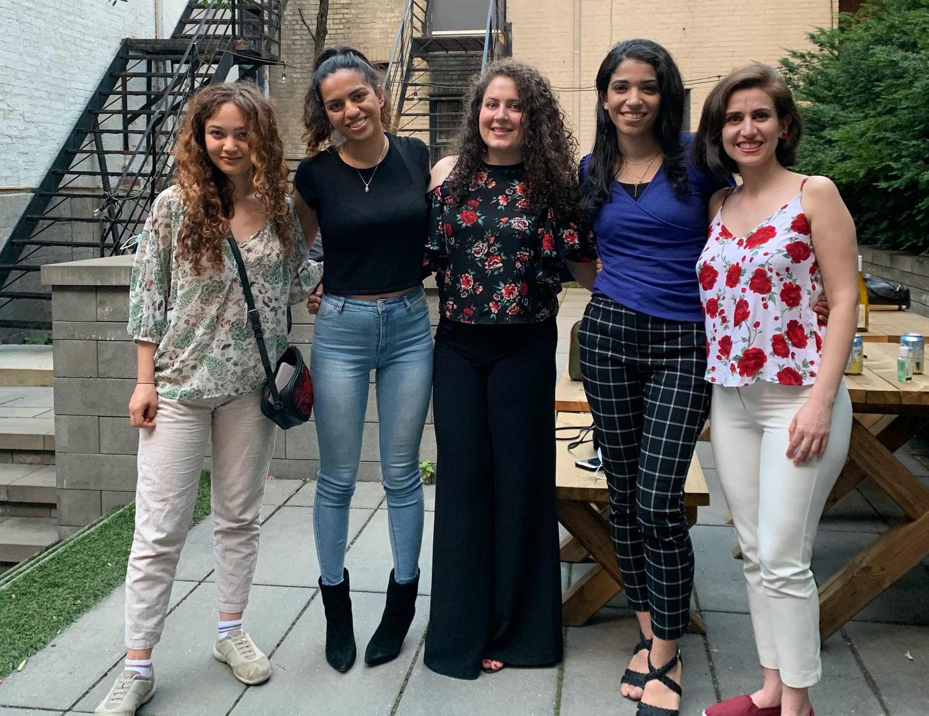
Team
Information technology engineering
Aida
Computer Science
Prakriti
Biomedical Engineering
Alaa
Electrical Engineering/ Entrepreneurship
Negin
Cognitive Science
Nadia
Notes:
No one should die from a disease that is preventable. Our interdisciplinary team hopes to build a tool that will improve the long-term prognosis of cervical cancer by accelerating its diagnosis

Slide 34
Thank you AI4Good
AI4Good Lab
Summer 2020
Notes:
We would like to thank all the AI4Good Lab affilites who gave us this great experience

Slide 35
Cervical Cancer= = = Preventable Disease
Cervical Cancer = = = Preventable Disease
Cervical Cancer = = = Preventable Disease
Cervical Cancer = = = Preventable Disease

